Slide 1
Web development ASTRONOMY IRELAND WEBSITE PROPOSAL
FRANCES LAMBE

Slide 2
Topics covered
Analysis of current site
Research
Proposed site
Wireframes

Slide 3
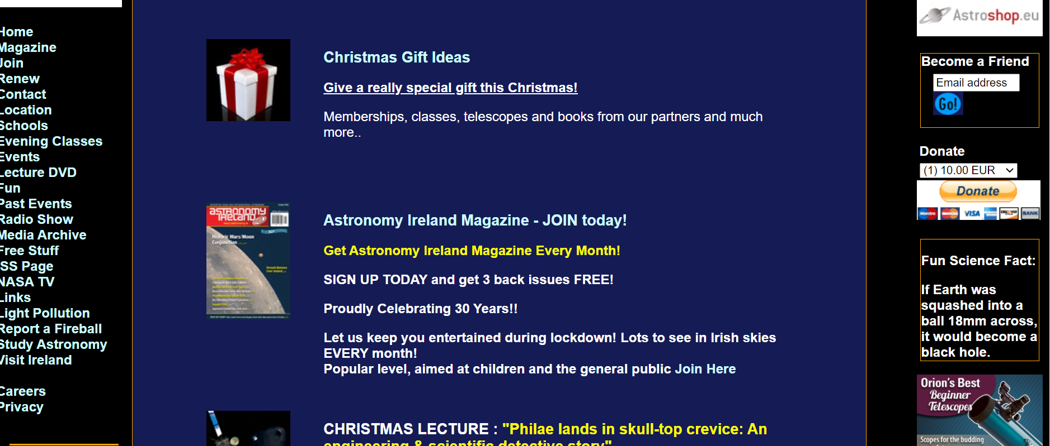
Analysis of current site
Overall very outdated layout that is not in use anymore.
Little to no use of Negative space

Slide 4
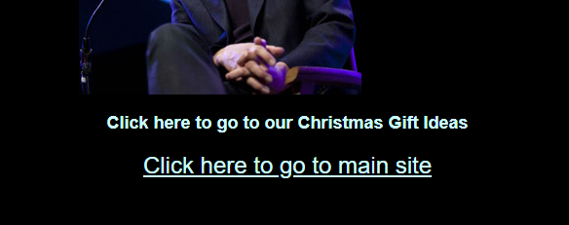

Analysis of current site (continued)
Navigational issues.
Inputting too much content into one space.
Lack of responsiveness
Counterintuitive- come underlined content are not hyperlinks while others are.
Hyperlink vs. no hyperlink

Slide 5
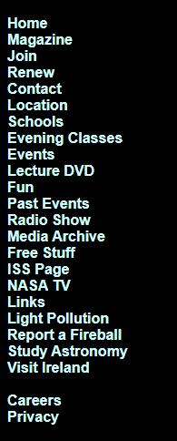
Analysis of current site (continued)
Too many primary navigation options.
Appearance, pages require a lot of scrolling but information doesn’t continue on all margins.
Lack on consistency as only certain pages include a footer.
Several links included in the website are outdated and expired, user needs to navigate back to website if this occurs.

Slide 6
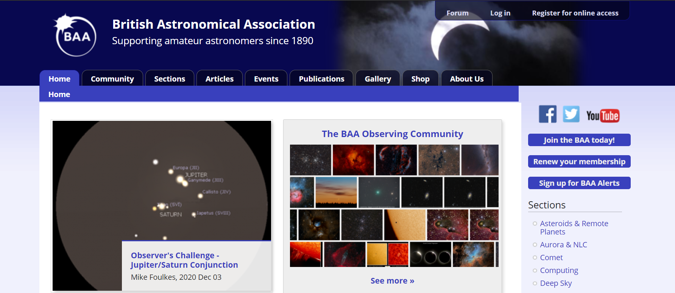
Research
British Astronomical Association

Slide 7
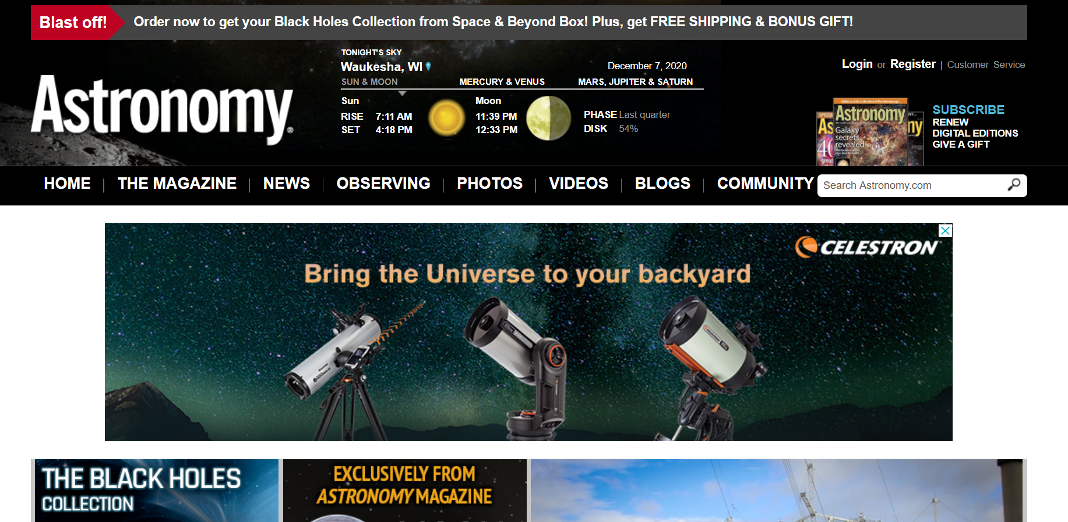
Research
Astronomy.com- based on magazine website

Slide 8
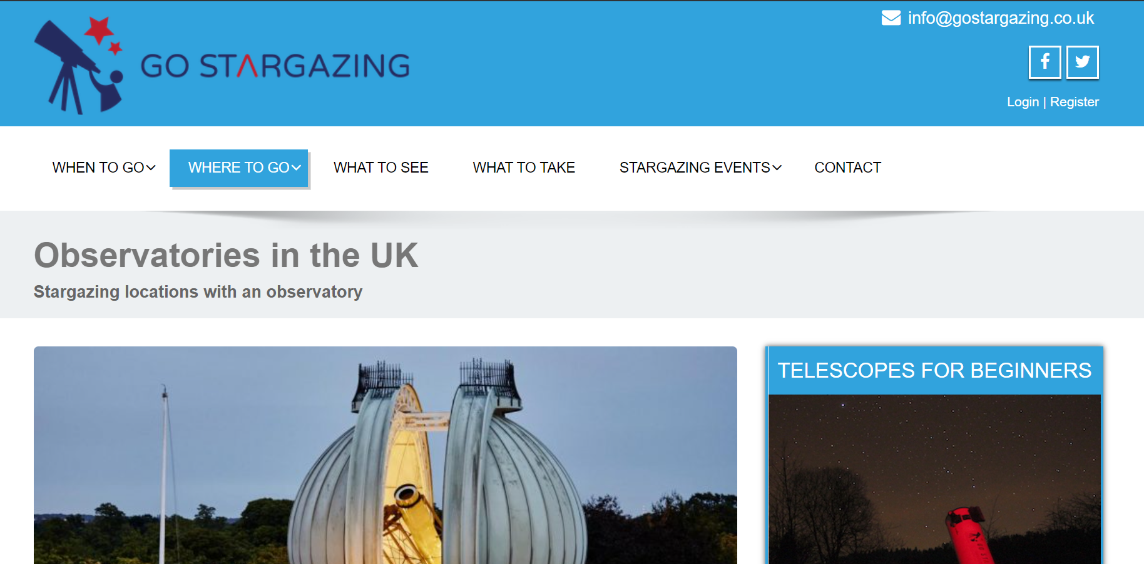
Research
Go Stargazing UK site

Slide 9
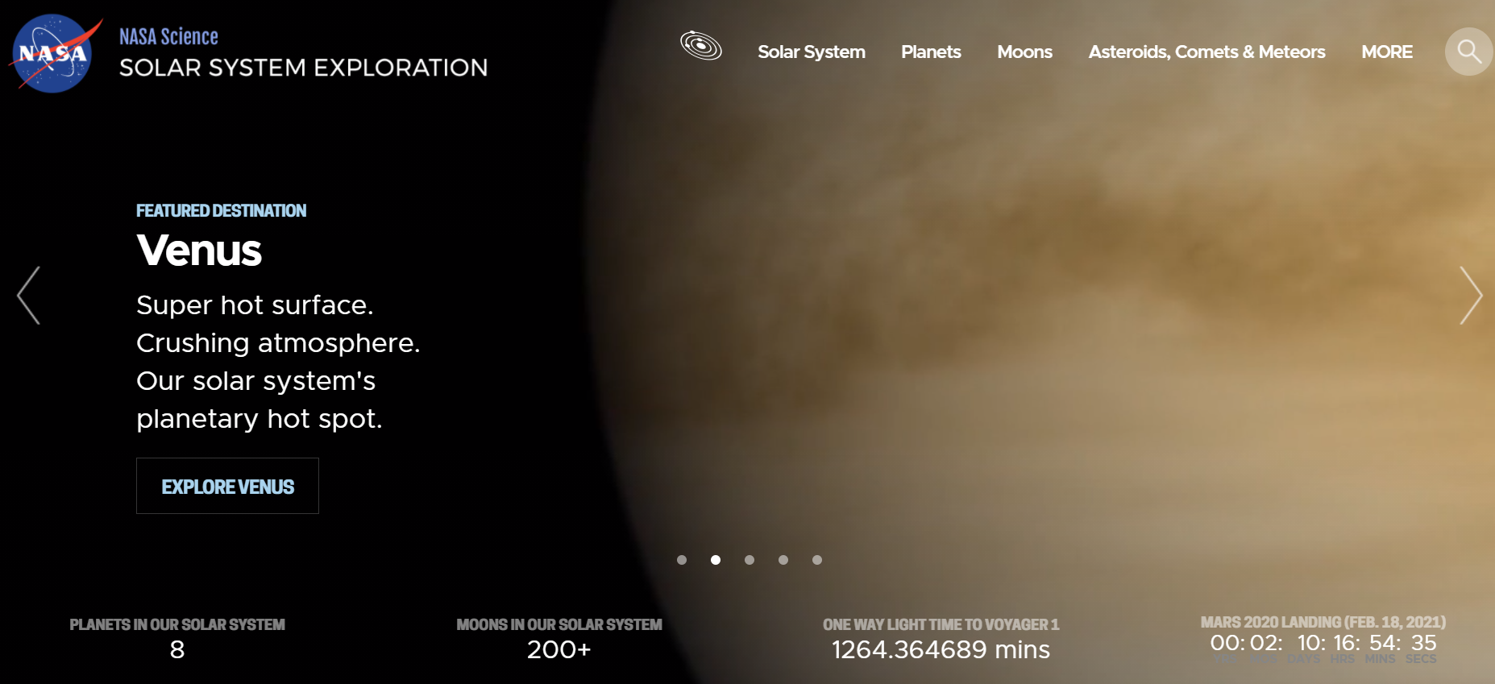
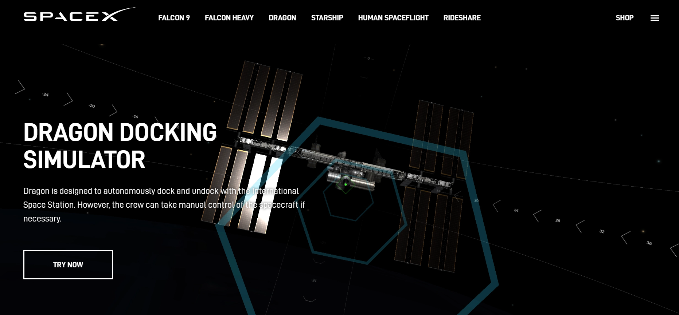
Research
NASA & SpaceX

Slide 10
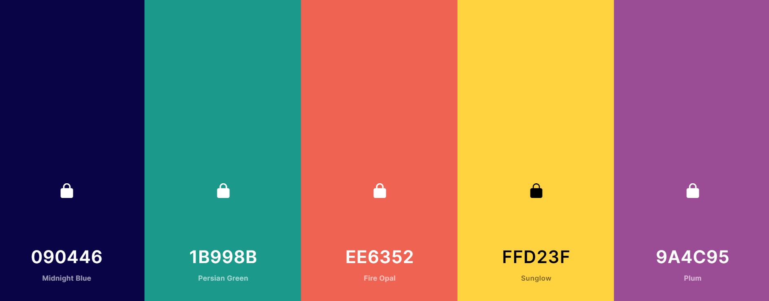
Proposed site- Colour
Using the information gathered on similar websites.
Colour Palette created based on similar website research

Slide 11
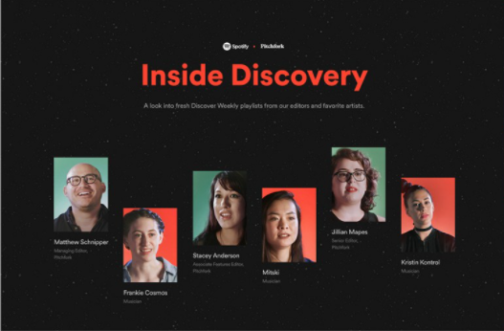
Proposed site- Colour
Darker Palettes with Bright text and content boxes appear more modern & would work well with current space theme.

Slide 12
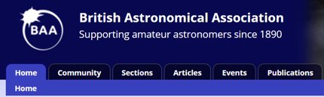
Proposed site
Primary navigation will be horizontal and highlighting where you are on site similar to below

Slide 13
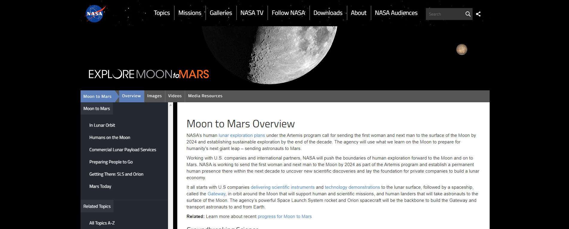
Proposed site
The site will look more modern with sufficient negative space similar to NASA’s site below, makes information stand out more.

Slide 14
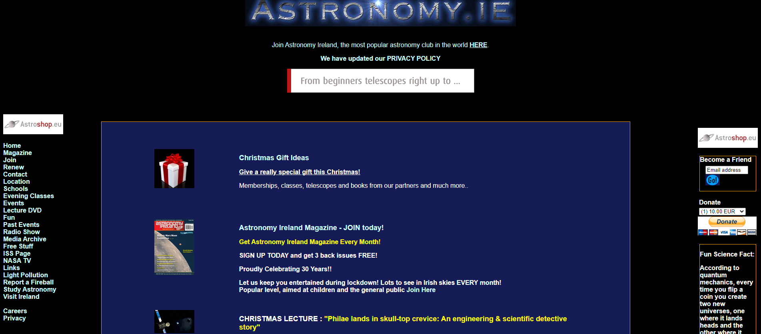
Proposed site
As opposed to Astronomy Ireland’s current site.
Fills every part of the page with content.

Slide 15
Conclusion
The current Astronomy Ireland website colour scheme is in keeping with the space theme.
Its navigation is much poorer than comparable websites.
Similar to other educational websites, the windows are content- heavy.
Negative spacing would add to the website’s sophistication.
A responsive site will mean all user types can benefit.

